Slide 1
Deep Learning
Convolutional Neural Network
How do they work?
Marya Butt, PhD.
Researcher Data Driven Smart Society (DDSS)
BIG DATA, Computer Vision, Machine Learning
Faculty of Engineering Design and Computing
Mob: +31(0) 0611878759
E: marya.butt@Inholland.nl

Slide 2
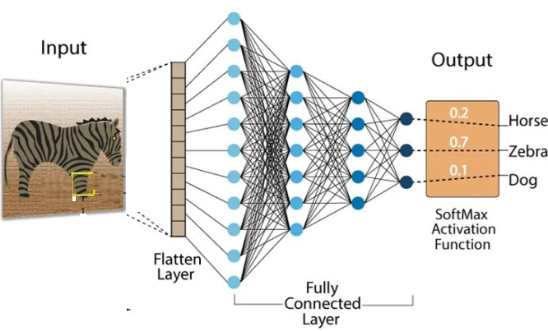
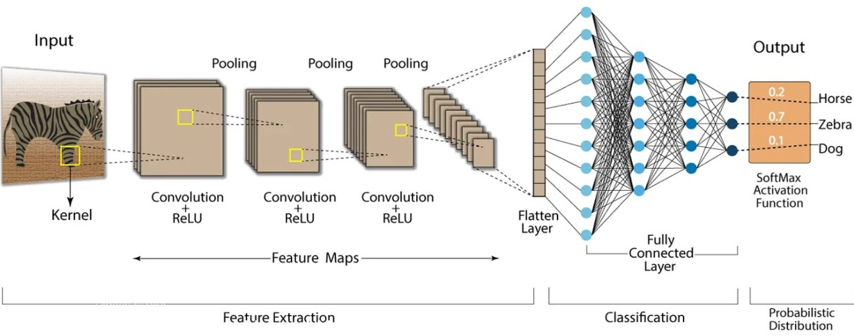
CNN blocks are added to extract features (before dense layers)

Slide 3
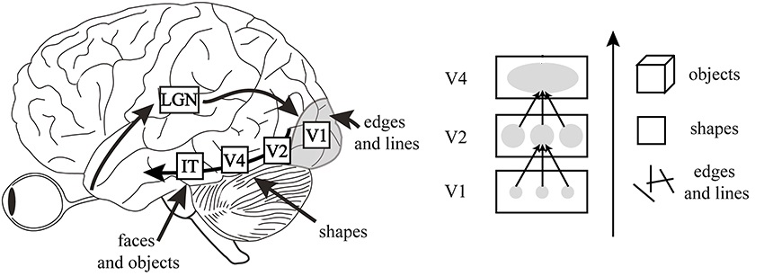
Convolution NN
Feed-forward neural network=> connectivity pattern=> inspiration=>visual cortex
e.g. small regions of neurons

Slide 4
Convolution Neural Network CNN has following layers -Convolution Layer -ReLU Layer -Pooling Layer -Fully Connected Layer
X
Convolution
NN
0
Convolution
NN

Slide 5
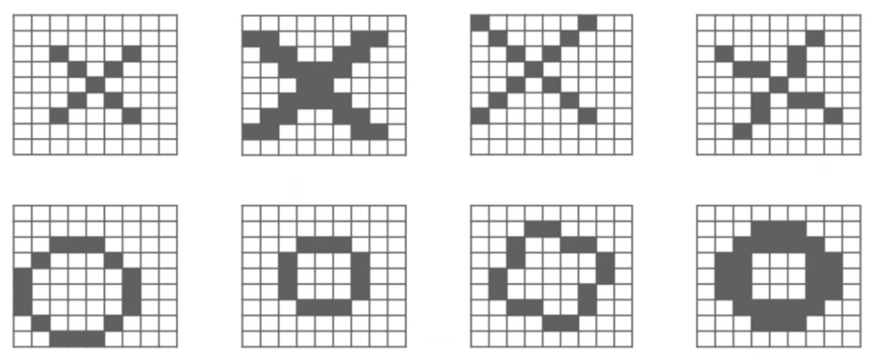
Problem with the dataset (Deformed Cases) -not every case is ideal -still required the right classification
X
o

Slide 6
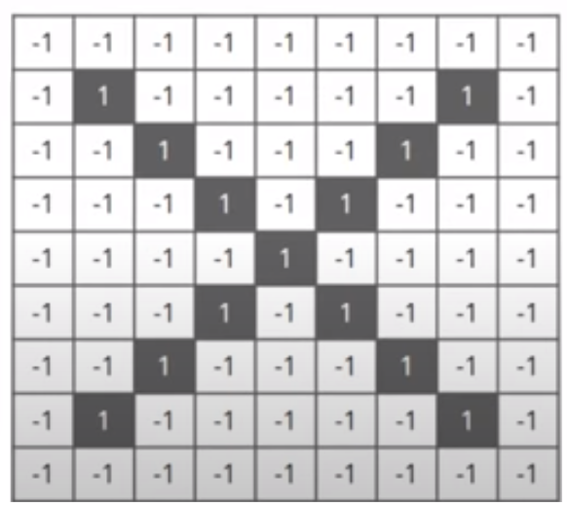
Pixel value assignment computer takes an image by pixel value

Slide 7
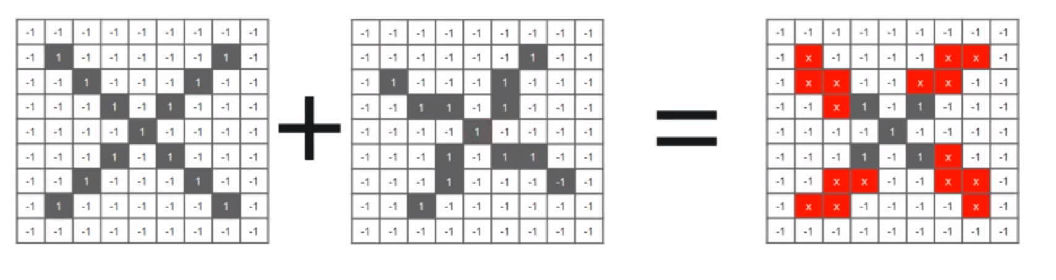
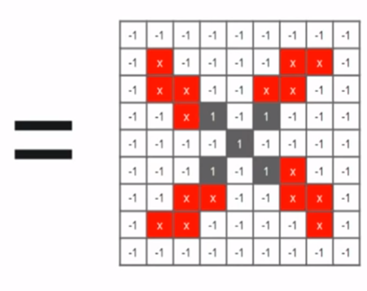
Under normal techniques(images comparison)

Slide 8
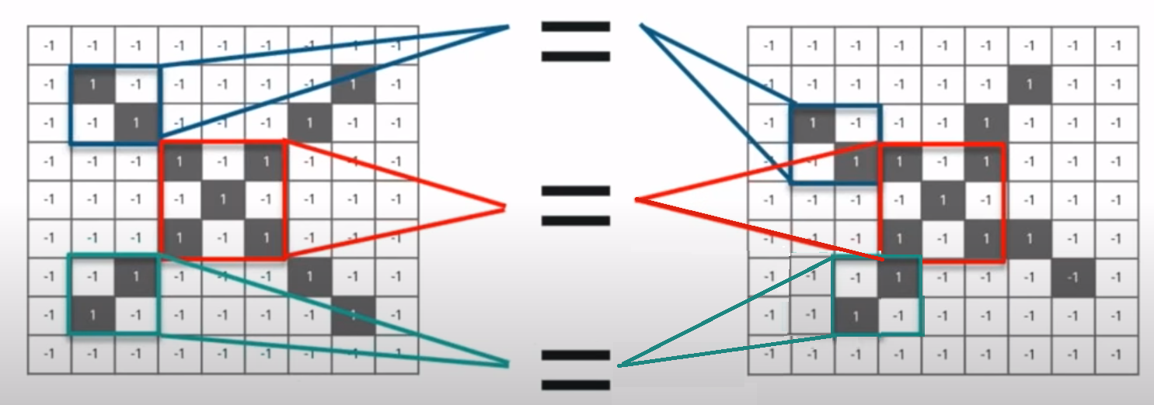
With CNN comparison block-by-block(features) feature matching at roughly same places of both images CNN is better in finding similarity

Slide 9
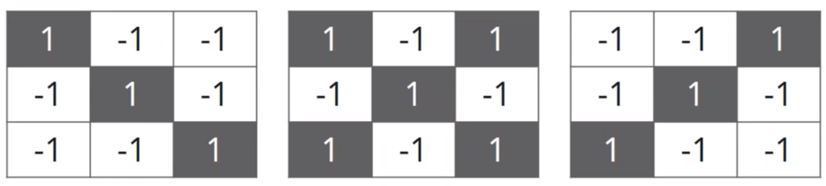
With CNN Chosen features

Slide 10
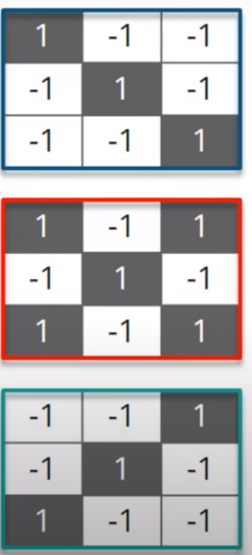
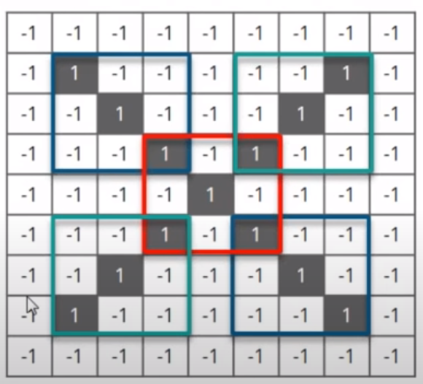
CNN feature matching⬄ input image

Slide 11
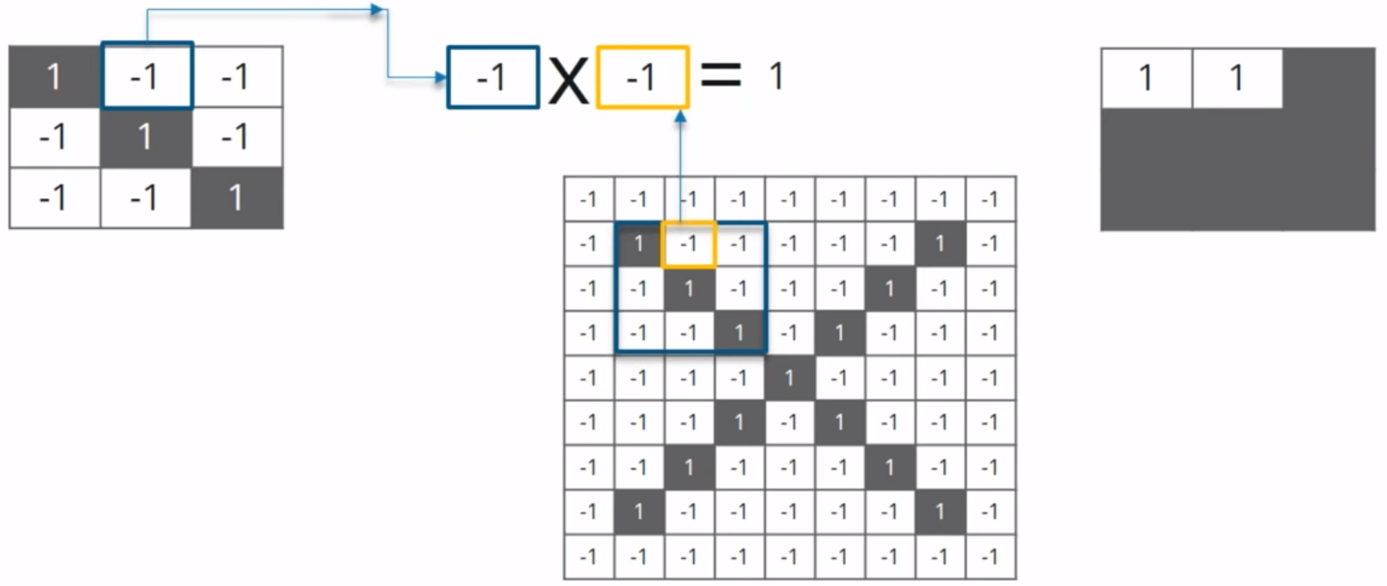
Convolution Layer (Move feature on the Image) Step 1: Multiply feature element with the image pixel

Slide 12
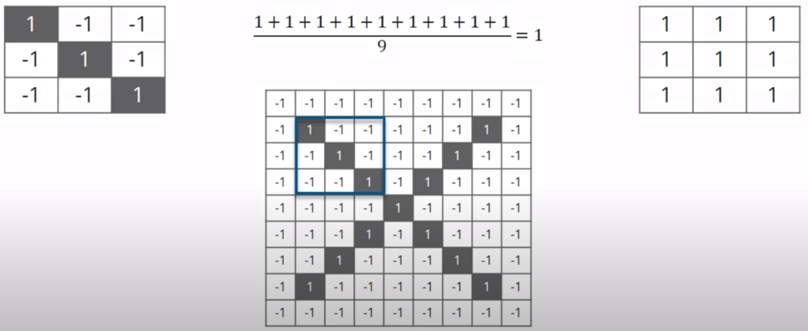
Convolution Layer (Move feature on the Image) Step 2: add them and divide by total no. pixels

Slide 13
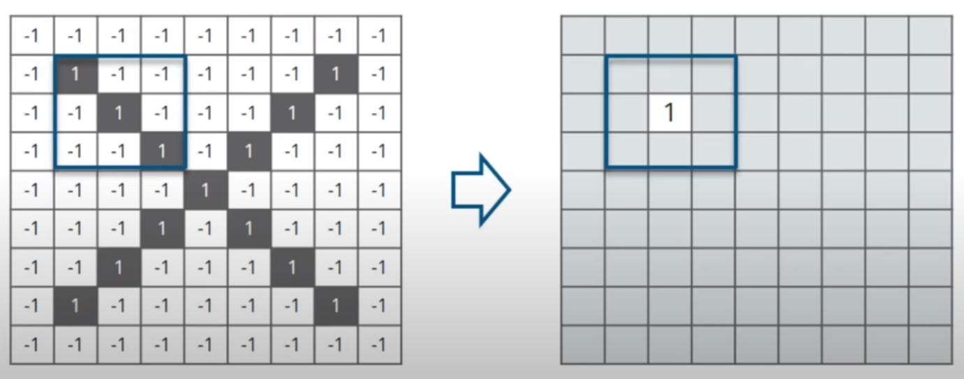
Value Placement
Value is placed in matrix at corresponding position

Slide 14
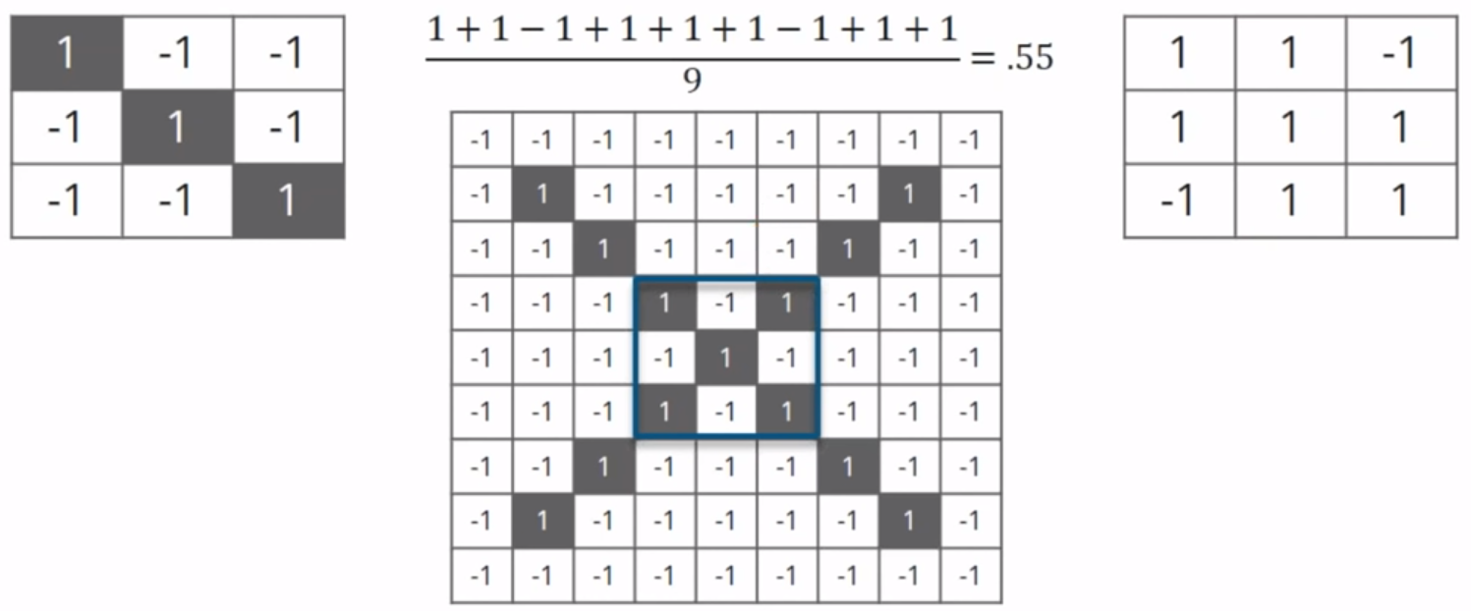
Feature Sliding
Same feature
Another location

Slide 15
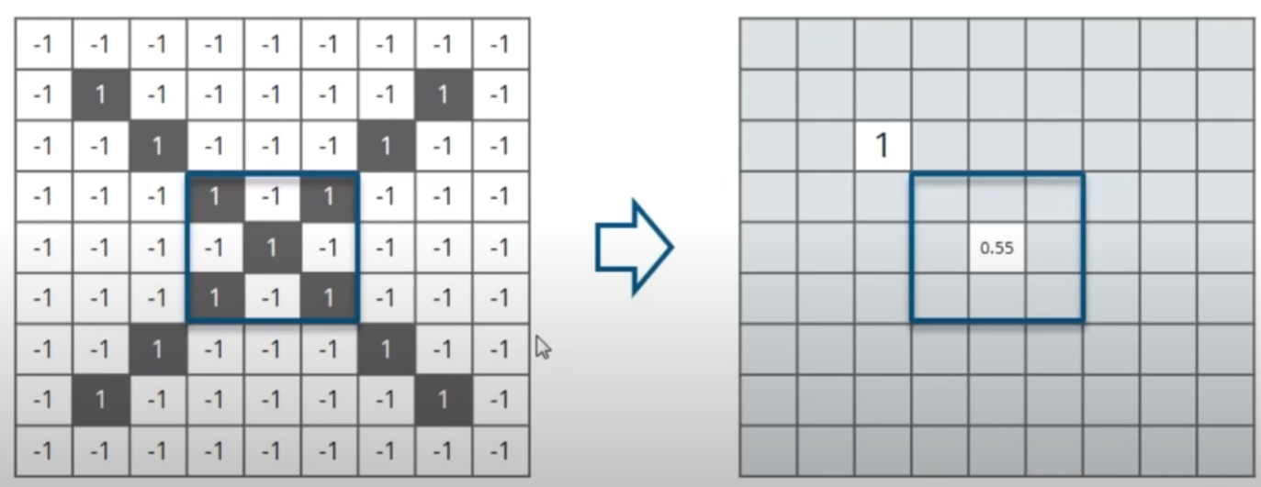
Value Placement
Value is placed at that corresponding position

Slide 16
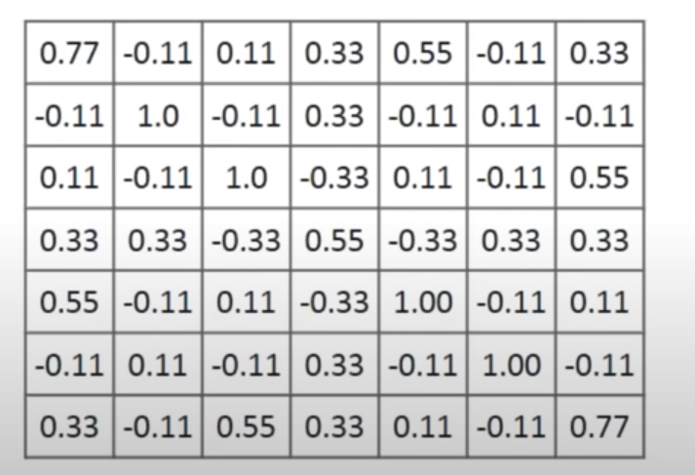
Convolution layer Output Feature movement ⬄every other position of the image ⬄ Feature Map

Slide 17
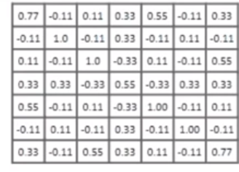
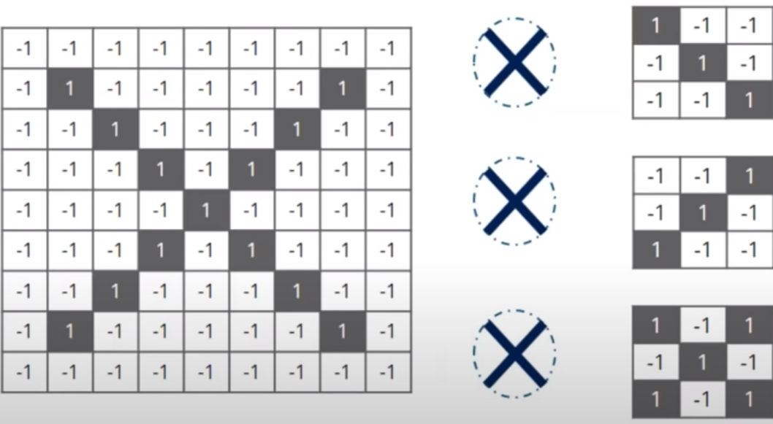
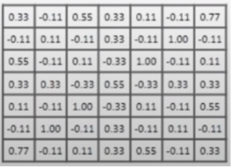
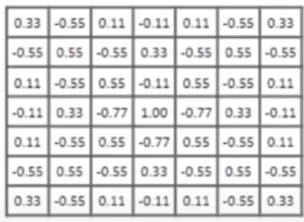
Convolution Layer Output Each feature convolution with the input image (3 Feature Maps)

Slide 18

ReLu Layer negative values removal=> 0 replacement Why? Avoid summing up to 0 f(x)=
0 if x<0
x if x>=0
Rectified Linear Unit (ReLu) funtion
launches node <-> input > certain value
If iput< 0 => output =0
If input> threshold value
Linear relationship with the DV

Slide 19
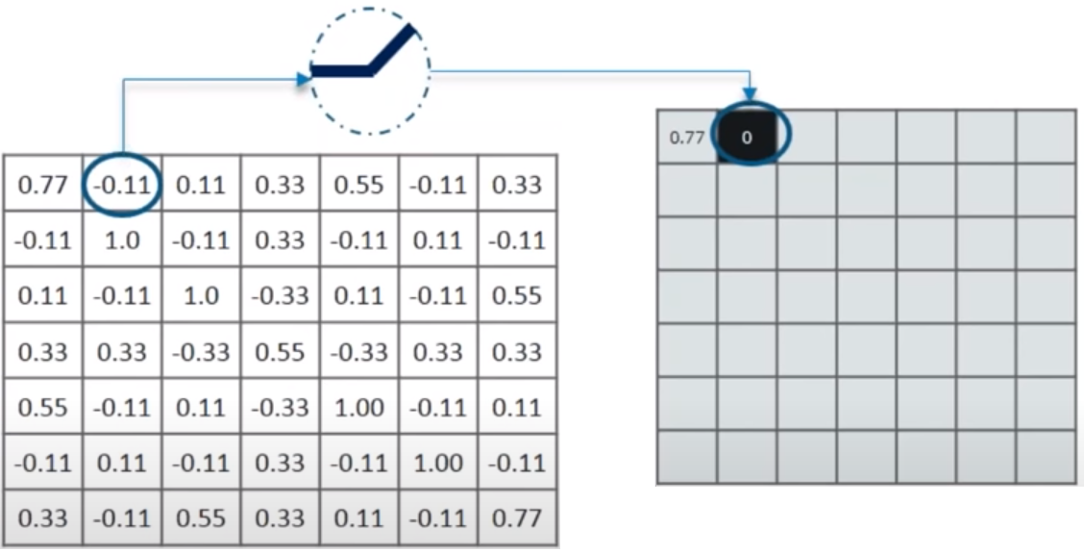
ReLu Layer Negative values removal

Slide 20
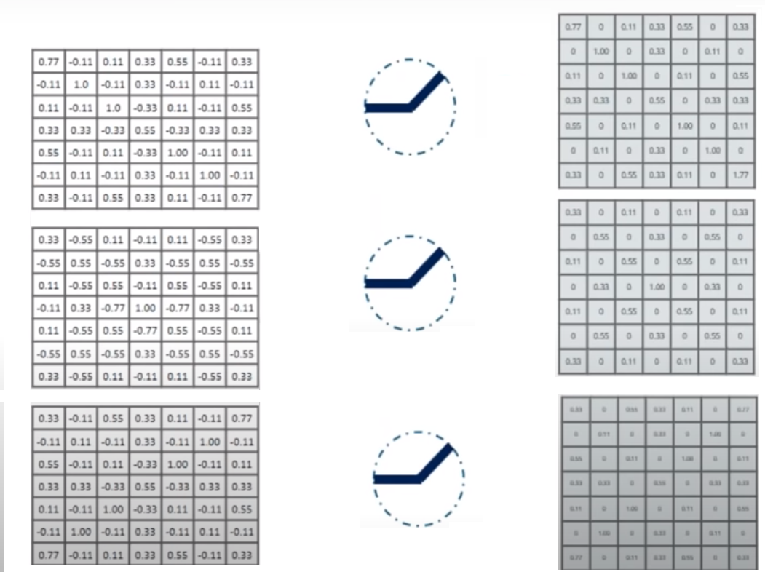
ReLu Layer Output

Slide 21
Pooling Layer
Image Compression
Choose window size (2 or 3)
Choose Stride(1 or 2)
Move window across the entire filtered image
Choose the max. value from each window
Lets apply pooling on the output of ReLu layer

Slide 22
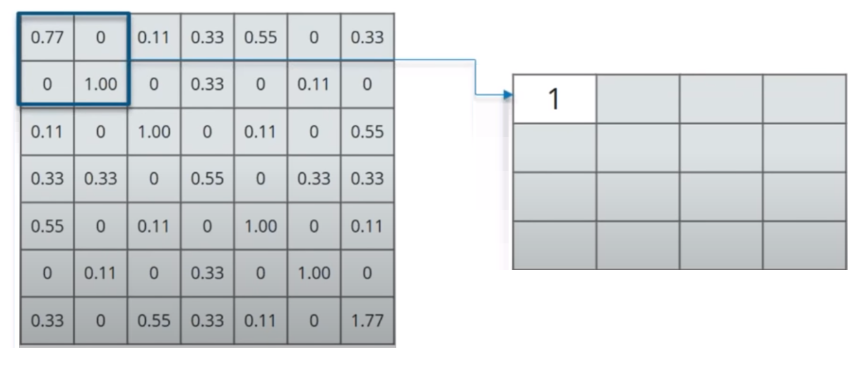
Pooling Layer 2x2 window Stride=2
0.33
0.55

Slide 23
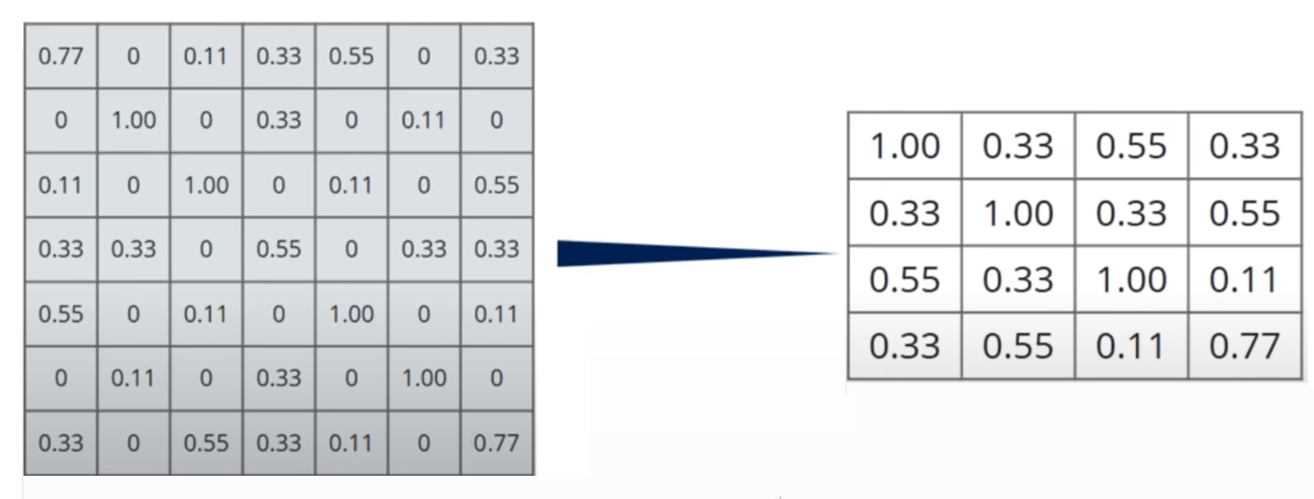
Pooling Layer 2x2 window Stride=2

Slide 24
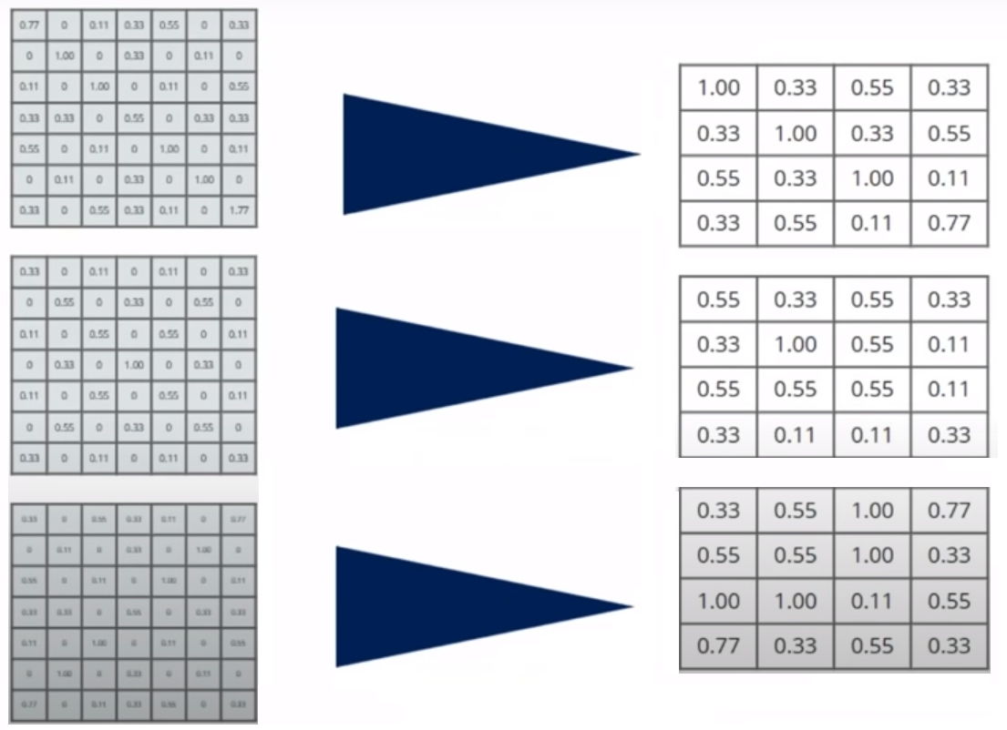
Pooling Layer

Slide 25
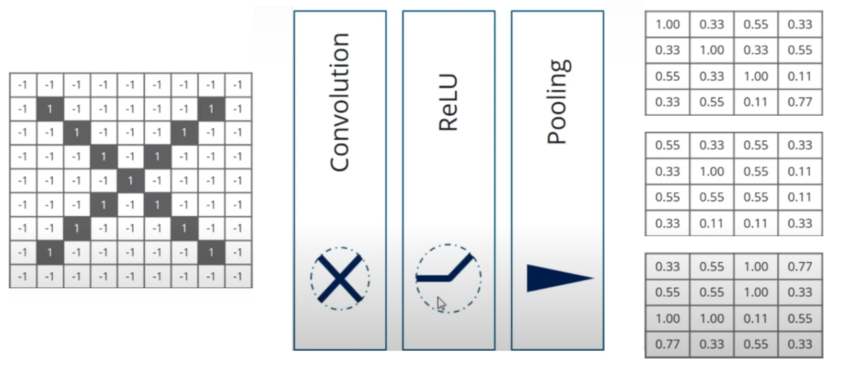
Layers Stacking

Slide 26
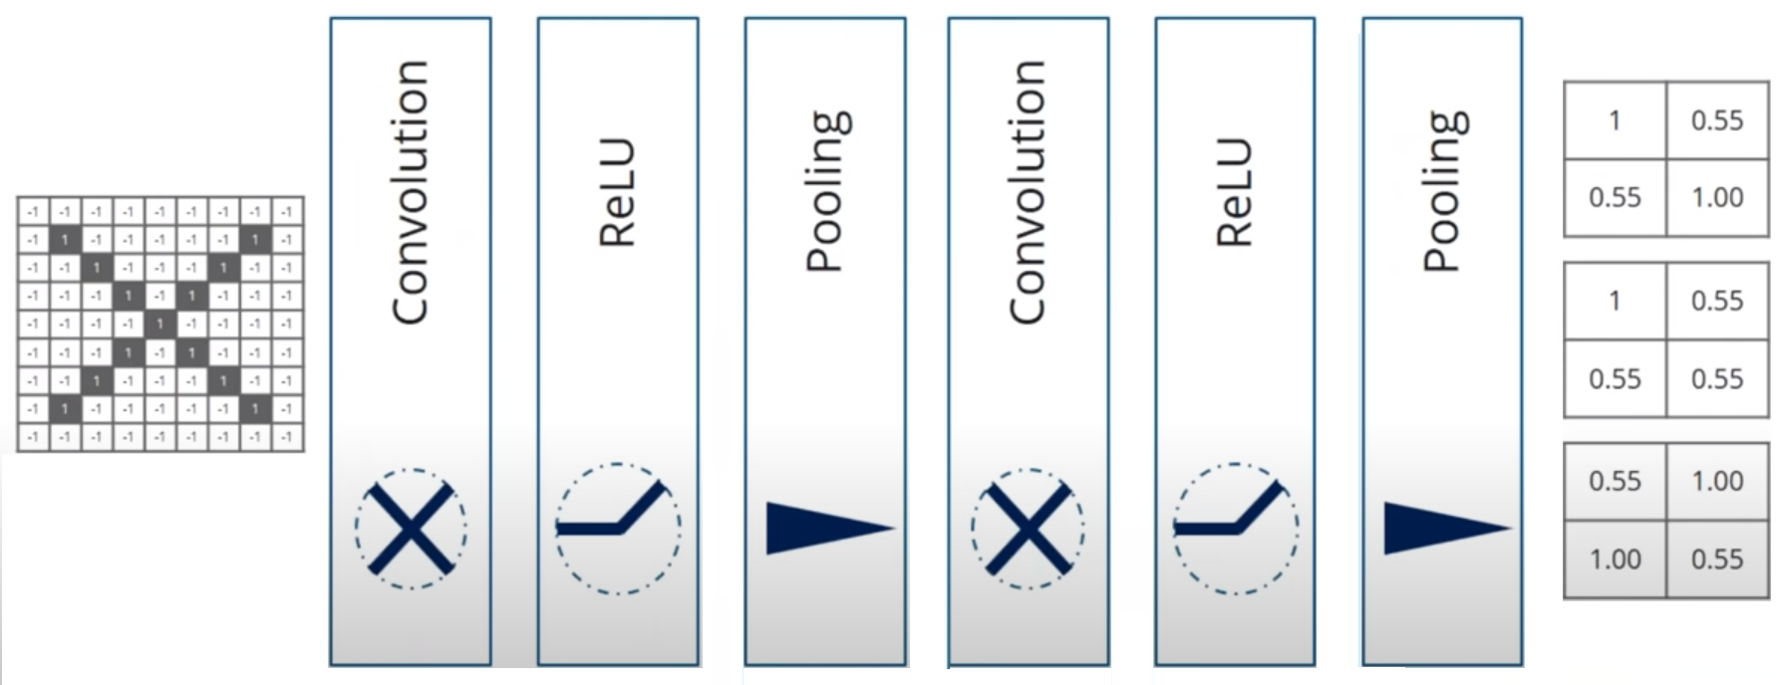
Layers Stacking another layer of convolution, ReLu, and Pooling
7x7
4x4
2x2

Slide 27
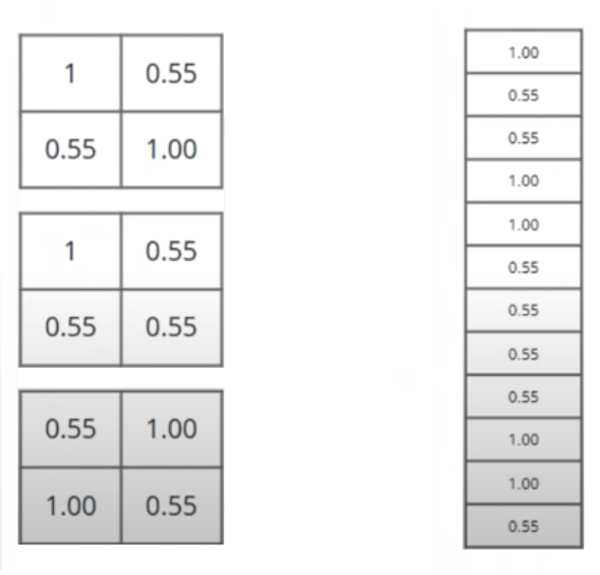
Fully Connected Layer final layer => actual classification reduced image=>single list/vector
Flattened

Slide 28
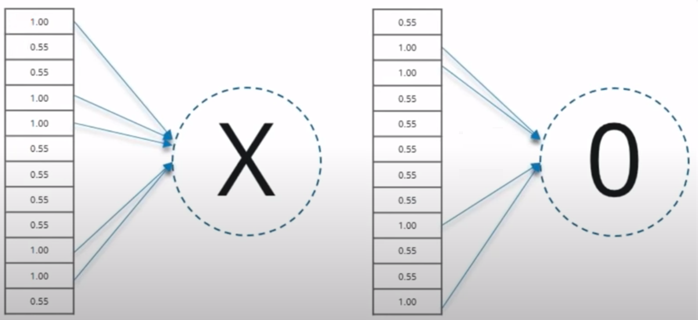
Output vector ‘X’ & ‘O’ elements=> high, low

Slide 29
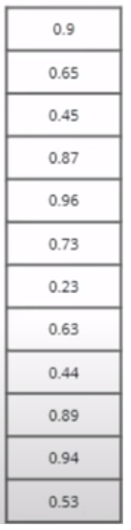
Prediction Classify it as either X or 0?
new input vector

Slide 30
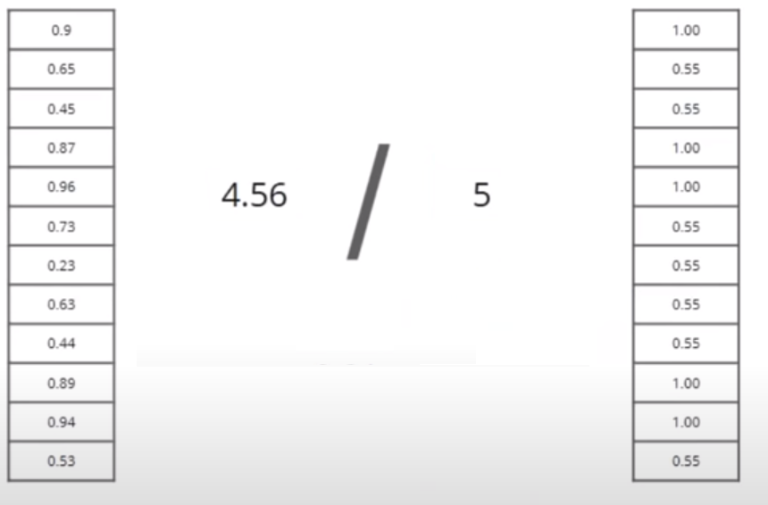
Comparing input with X vector
Input vector
X vector
Sum
Sum
.91

Slide 31
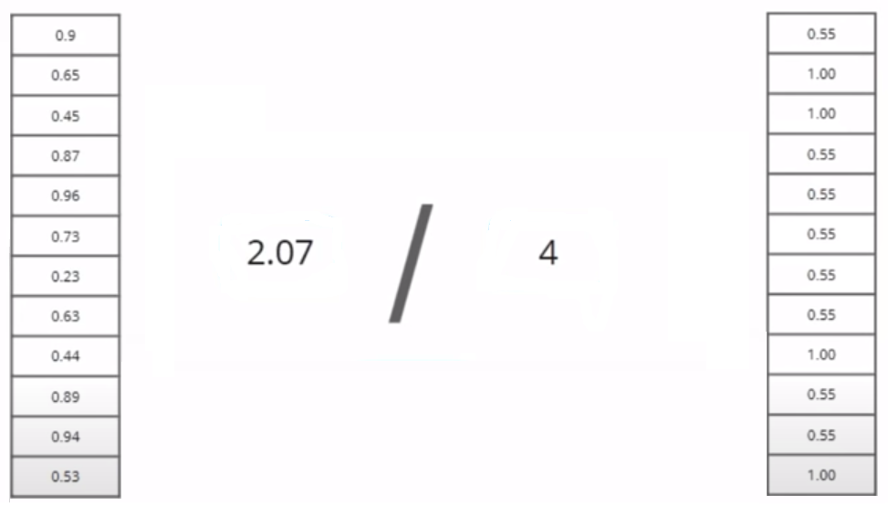
Comparing input with O vector
Input vector
O vector
Sum
Sum
.51

Slide 32
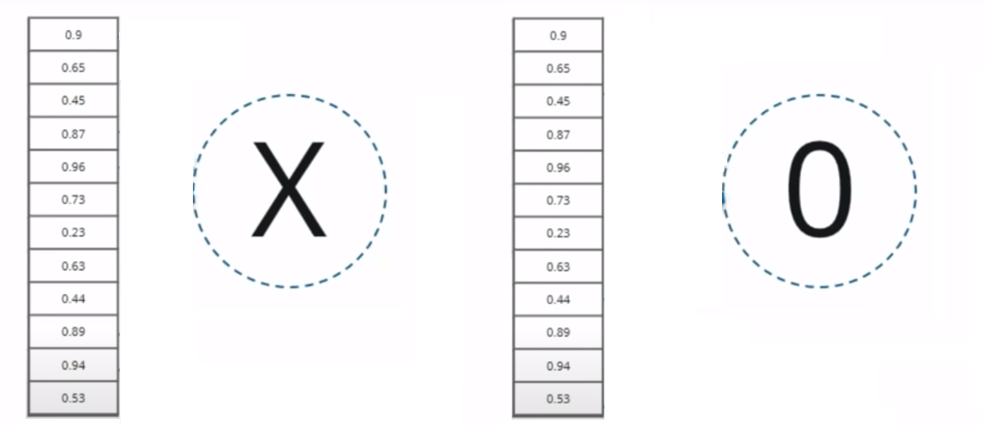
Results
.91
.51
The input image is classified as X

Slide 33
1 Block, 2 Block, 3 Block
model = Sequential()
model.add(Conv2D(32, (3, 3), activation='relu', padding='same', input_shape=(300, 200, 3)))
model.add(MaxPooling2D((2, 2)))
model.add(Conv2D(64, (3, 3), activation='relu', padding='same'))
model.add(MaxPooling2D((2, 2)))
model.add(Conv2D(64, (3, 3), activation='relu', padding='same'))
model.add(MaxPooling2D((2, 2)))
###Fully connected Layer
Model.add(Flatten())
model.add(Dense(128, activation='relu'))
model.add(Dense(1, activation='sigmoid’))
Activation Function= Sigmoid or Softmax

Slide 34
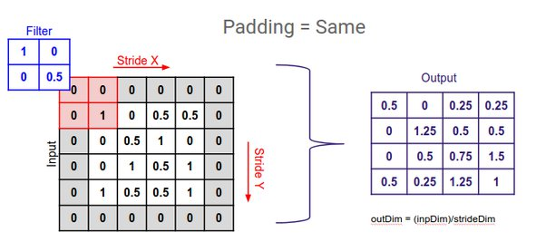
Why to set padding=same?

Slide 35
# compile model model.compile(optimizer='adam',loss='categorical_crossentropy’,metrics=['accuracy']) Loss= cross entropy or MSE

Slide 36
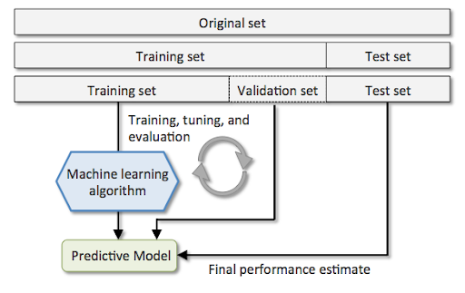
Training, Validation & Testing
Deep Learning Algorithm

Slide 37
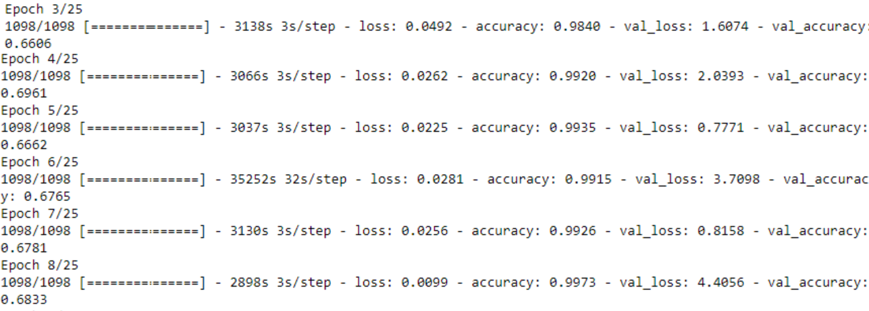
Fitting a model

Slide 38
Plot the diagnostics
plt.plot(history.history['acc'],'green',label='Accuracy')
plt.plot(history.history['loss'],'red',label='Loss')
plt.title('Training Accuracy & Loss')
plt.xlabel('Epoch')
plt.figure()
plt.plot(history.history['val_acc'],'green',label='Accuracy')
plt.plot(history.history['val_loss'],'red',label='Loss')
plt.title('Validation Accuracy & Loss')
plt.xlabel('Epoch')
plt.figure()

Slide 39
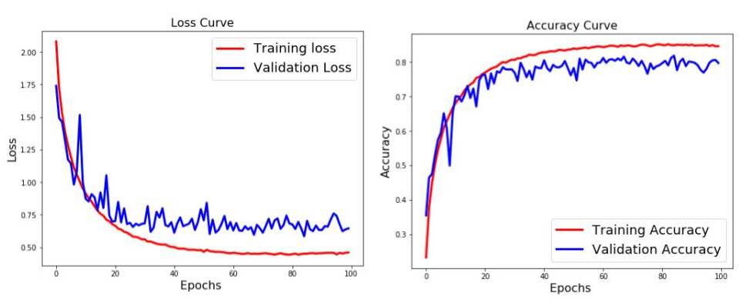
Loss Curve & Accuracy Curve

Slide 40
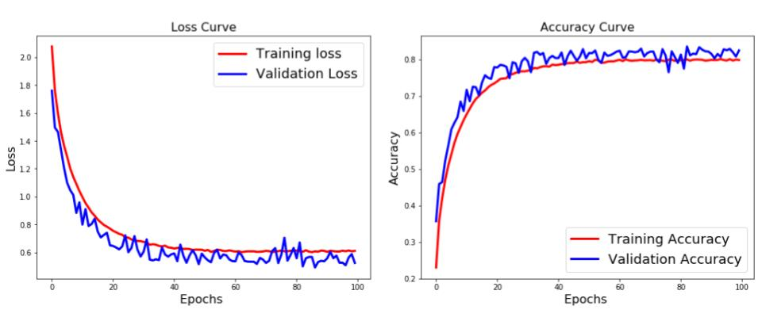
Image Augmentation

Slide 41
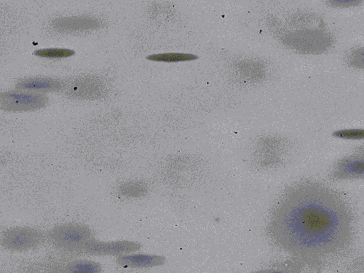
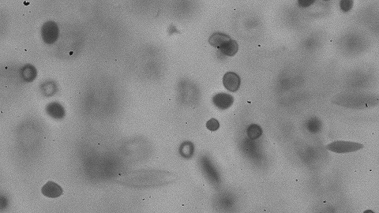
Use Case A pharmaceutical company carries out research on blood samples. They recieve two types of blood samples. The blood samples images are microscopic and they want to classify them as either healthy RBCs(Red Blood Cells) or Sickle Cells.

